Slide 1
AMLD

Slide 2
Agenda
Agenda:
Introduction — 15 minutes — general description, motivation, who are we, etc…
Scientific machine learning — what is it, what’s the point / Incorporating physics contraints — review, why do we do it, different ways to do it — 75 minutes
Break — 30 minutes
Reproducibility in ML — what are we talking about, reproducibility, research results, what is important, etc — 90 minutes
pipeline — different tools — 30 minutes
Presenting dataset 30minutes
Costumizing loss functions in Keras — 30 minutes
Using a established framework — 30 minutes

Slide 3
What is this workshop about?
Focus on relevant ML practices in academia / scientific context
ML is used as a tool to give us insights into problems, solve problems quicker, understanding things better
It is another tool, as numerical simulations (for example), are a tool to best understand science
As such, we need good practices and standards to use ML
Difference between ML in industry and in Science — we often have answers to the problems — we have constraints that must be fulfilled. Things which are obviously wrong — that traditional metrics do not measure.

Slide 4
Who are we

Slide 5

Some general discussion …
An informal survey conducted at MIDAS, where 8 data scientists discussed current trends of ML in various fields of academia has yielded the following insights
There is no formal standard when it comes to publishing ML related material in various fields (e.g.: mathematics, psychology, physics, political science, economics).
In computer science there is some incentive to publish code/datasets (e.g.: paperswithcode / paperswithoutcode, as well as upon submission of materials in conferences / journals).
Although there is awareness of various tools to keep track of the development of code / data / models, there is no consensus or common practices in each field.
It falls upon the researcher to find ways to keep track of their pipelines. For example, excel files, annotated code, github, google spreadsheets to keep track of model changes / results, read me files to describe dataset/code.

Slide 6
Some general discussion …
After a project is concluded, typically the results are stored in hard drives, github (which is not always maintained), Dropbox type accounts, Cluster, publicly available data (academictorrents.com, dryad.com) or published along with the paper.
However, the consensus was that there was no good guide or principles for development of ML systems geared towards academic purposes.

Slide 7
Scientific Data Science
Incorporating domain knowledge and other considerations

Slide 8
Agenda
What we will talk about — examples
This also crosses to industry because there’s also domain knowledge
Requires understanding ML
How to incorporate physical knowledge
Interpretability and uncertainty

Slide 9
Motivation
Brunton, S., & Kutz, J. (2019). Data-Driven Science and Engineering: Machine Learning, Dynamical Systems, and Control. Cambridge: Cambridge University Press.
More than 50 years ago, John Tukey envisioned the existence of a scientific effort focused on learning from data.
Data analysis / Data science has been largely dominated by two distinct cultural outlooks on data
Machine learning community: pre-dominantly comprised of computer scientists and typically centered on prediction quality and scalable, fast algorithms
Statistical learning community: often centered in statistics departments, focuses on the inference of interpretable models.
Both methodologies have achieved significant success and
provided the mathematical and computational foundations for data-science methods.
Notes:
Data science itself is not new, having been proposed more than 50 years ago by John Tukey who envisioned the existence of a scientific effort focused on learning from data, or data analysis [152]. Since that time, data science has been largely dominated by two distinct cultural outlooks on data

Slide 10
Motivation
Brunton, S., & Kutz, J. (2019). Data-Driven Science and Engineering: Machine Learning, Dynamical Systems, and Control. Cambridge: Cambridge University Press.
For engineers and scientists, the goal is to leverage these new techniques to infer and compute models (typically nonlinear) from observations:
That correctly identify the underlying dynamics;
Generalize qualitatively and quantitatively to unmeasured parts of phase, parameter, or application space.
Another scientific tool (like numerical simulations)
Much less developed theory
Notes:
Data science itself is not new, having been proposed more than 50 years ago by John Tukey who envisioned the existence of a scientific effort focused on learning from data, or data analysis [152]. Since that time, data science has been largely dominated by two distinct cultural outlooks on data

Slide 11
Two big tools in science and engineering
Numerical simulations:
Many processes can be studied through ordinary / partial differential equations
A lot of advances in science occur through the study and numerical solution of such systems of equations
Data Analysis:
Miles you probably can say more about this :D
Notes:
Non parametric in the sense of we don’t have to specify, for example, the maximal degree of polynomial for the basis, etc. there are still parameters ofc.

Slide 12
Uses of ML in scientific context
Improving predictions beyond state-of-the-art physical models
First-principle models are based on known physical laws.
Physical processes are often multi-scale
In most cases, first-principle models are approximations of reality
Uncertain parameters
Simplified (do not solve all scales/account for all physics)
E.g.: smaller scales are introduced by subgrid models
Notes:
Non parametric in the sense of we don’t have to specify, for example, the maximal degree of polynomial for the basis, etc. there are still parameters ofc.

Slide 13
Uses of ML in scientific context
Improving predictions beyond state-of-the-art physical models
Machine Learning methods can be seen as non-parametric function approximators
Can be used to account for missing physics (functional subgrid models)
Can be used to scale-up previously intractable problems
Notes:
Non parametric in the sense of we don’t have to specify, for example, the maximal degree of polynomial for the basis, etc. there are still parameters ofc.

Slide 14
Uses of ML in scientific context
Improving predictions beyond state-of-the-art physical models
Planetary collision
Notes:
Non parametric in the sense of we don’t have to specify, for example, the maximal degree of polynomial for the basis, etc. there are still parameters ofc.

Slide 15
Uses of ML in scientific context
Deep Potential Molecular Dynamics: A Scalable Model with the Accuracy of Quantum Mechanics, L. Zhang et al. Phys. Rev. Lett. 120, 143001, 2018
Improving predictions beyond state-of-the-art physical models
Molecular dynamics is a way of studying the behavior of molecular and material systems by tracking the trajectories of all the nuclei in the system.
Particles obey Newton’s law, with some potential energy function V that models the interaction between particles (nuclei)
The main difficulty is obtaining V:
Compute on the fly using quantum mechanics models (e.g.: density functional theory)
Come up with empirical potentials
Notes:
Ofc the first method is very expensive and it’s pretty much limited computationally to systems of at most 1000 particle s(even in clusters)
The second method is very efficient but unreliable
You start seeing the pattern here – there’s a dilemma between accuracy and efficiency

Slide 16
Uses of ML in scientific context
Deep Potential Molecular Dynamics: A Scalable Model with the Accuracy of Quantum Mechanics, L. Zhang et al. Phys. Rev. Lett. 120, 143001, 2018
The main difficulty is obtaining V:
Compute on the fly using quantum mechanics models (e.g.: density functional theory)
Come up with empirical potentials
In this paper, a neural network is trained to generate an approximation to V, when trained with simulation coming from density functional theory. This way, the accuracy is similar to DFT but it is as efficient as empirical potentials.
Notes:
Ofc the first method is very expensive and it’s pretty much limited computationally to systems of at most 1000 particle s(even in clusters)
The second method is very efficient but unreliable
You start seeing the pattern here – there’s a dilemma between accuracy and efficiency

Slide 17
Uses of ML in scientific context
Surrogate modelling
Replacing expensive computation by a surrogate model
Given input and outputs, learn the mapping without having to solve computationally expensive models
Notes:
Work miles

Slide 18
Uses of ML in scientific context
Storage
Numerical simulations produce a lot of data
Use machine learning techniques to choose what data to keep, what data is redundant

Slide 19
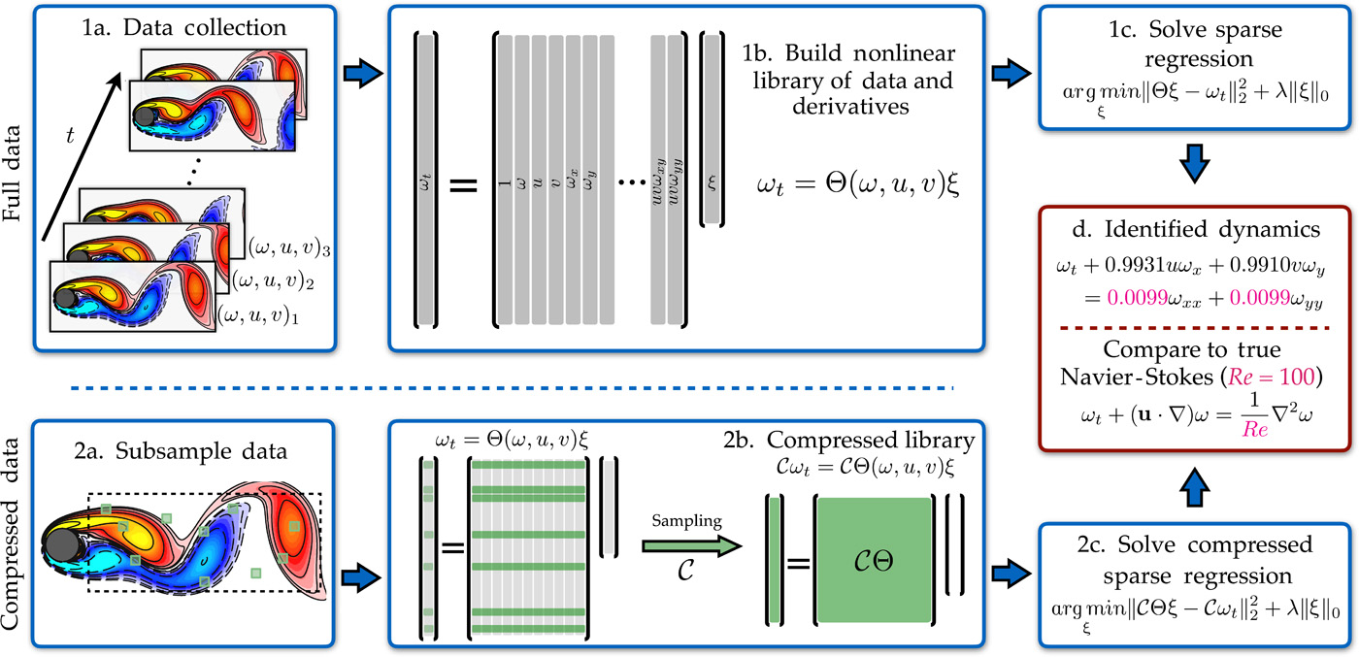
Uses of ML in scientific context
Data-driven discovery of partial differential equations, S. H. Rudy et al., Science Advances, 2017
Discovering governing equations
From observations, infer the underlying partial differential equation
Notes:
Komousakus stuff

Slide 20
Uses of ML in scientific context
Solving partial differential equations
Solving partial differential equations is still of large interest – many engineering and scientific problems can be formalized through a PDE.
Numerical solvers of PDEs are fiddly:
Require parameter tuning
Numerical considerations (e.g.: because of discretization, some systems of PDEs can’t be solved naively)
Computationally expensive
Notes:
Our work, google work, fluid

Slide 21
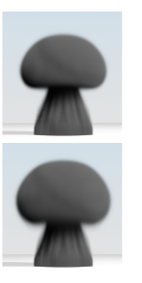
Uses of ML in scientific context
Jonathan Tompson, Kristofer Schlachter, Pablo Sprechmann, and Ken Perlin. 2017. Accelerating eulerian fluid simulation with convolutional networks. In Proceedings of the 34th International Conference on Machine Learning - Volume 70 (ICML'17). JMLR.org, 3424–3433.
Solving partial differential equations – incompressible flow
exact solution (Preconditioner Conjugate Gradient method)
Authors use a Convolutional Neural Network to solve resulting linear system
~100x speed up in comparison to CGD method
~1.5x speed up in comparison to iterative methods
Proposed method
Notes:
Our work, google work, fluid

Slide 22
Uses of ML in scientific context
Fourier Neural Operator for Parametric Partial Differential Equations L. Zongyi et al. arXiv:2010.08895, 2020
Solving partial differential equations – solving full fluid equation
Up to 1000x faster than traditional solvers
Notes:
Our work, google work, fluid

Slide 23
Uses of ML in scientific context
Many other applications:
Data storage
Tackling previously intractable problems
Inverse modelling
Uncertainty quantification
Parametrisation
Downscaling
Reduced order modelling

Slide 24
Limitations of using ML in science
Inconsistency with physical laws
Results which are obviously wrong that can lead to bad results, crash the system
Lack of theoretical guarantees do not inspire confidence
Interpolation versus extrapolation
Cool proof-of-concept projects, but a lot to be done to live up to the hype
Applications in science are stringent:
- very good defined notion of what is wrong
- traditional applications of machine learning are more forgiving (e.g.: machine translation)
- using scientific problems to test machine learning models opens doors to think about how to better make models
Notes:
Inconsistency with physical laws – for example, density field is negative

Slide 25
Incorporating domain knowledge
Respecting the constraints of the problem
Theoretical guarantees
Reducing the space of models in which we are searching
Notes:
Reducing the search space

Slide 26
Incorporating domain knowledge
Soft-constraint vs hard-constraint // invariance vs equivariance
A soft-constraint is some awareness of the constraint, but it’s not not guaranteed to be always respected
A hard-constraint gives the guarantee that the constraint is respected
Typically, a soft-constraint is easier to include, and degrades the performance less
Notes:
These are not formal definitions

Slide 27
Incorporating domain knowledge
Soft-constraint vs hard-constraint // invariance vs equivariance
Function invariance is a function whose output will not change with respect to the invariant property.
E.g.: Laplacian operator is rotation invariant
Function equivariance is a function whose output might change, but the end result does not change.
E.g.: typical convolutional neural networks are translation/rotation equivariant
Notes:
These are not formal definitions

Slide 28
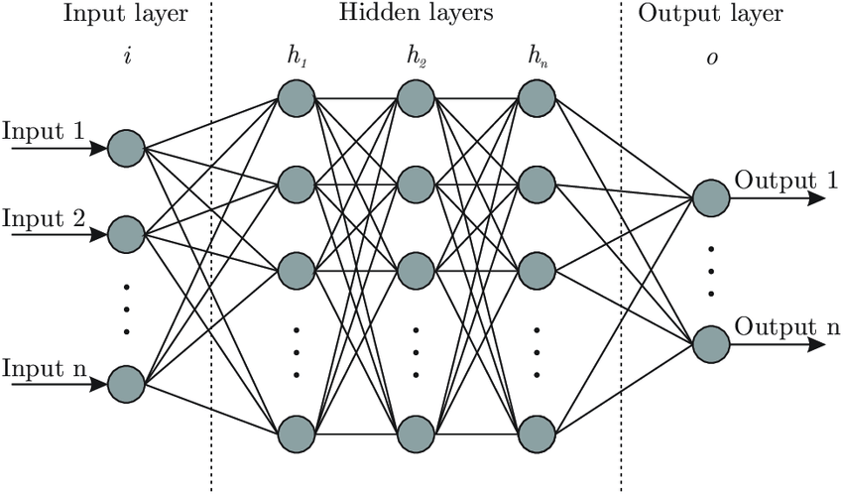
Incorporating domain knowledge
Neural networks
Dense deep neural network
Optimisation strategy
Gradient descent, ADAM, Ada
Minimizing some measure of optimality
Classification: cross-entropy
Regression: mean squared error
Notes:
Loss function

Slide 29
Incorporating domain knowledge
Neural networks
Modifying loss function:
For example, maybe the target has to be positive, so we penalize the prediction if it is negative.
Notes:
Loss function with external things

Slide 30
Incorporating domain knowledge
Neural networks
The same idea can also enforce bounds in the prediction
We can also use information from the features. For example, for conservation purposes.
Notes:
Loss function with external things

Slide 31
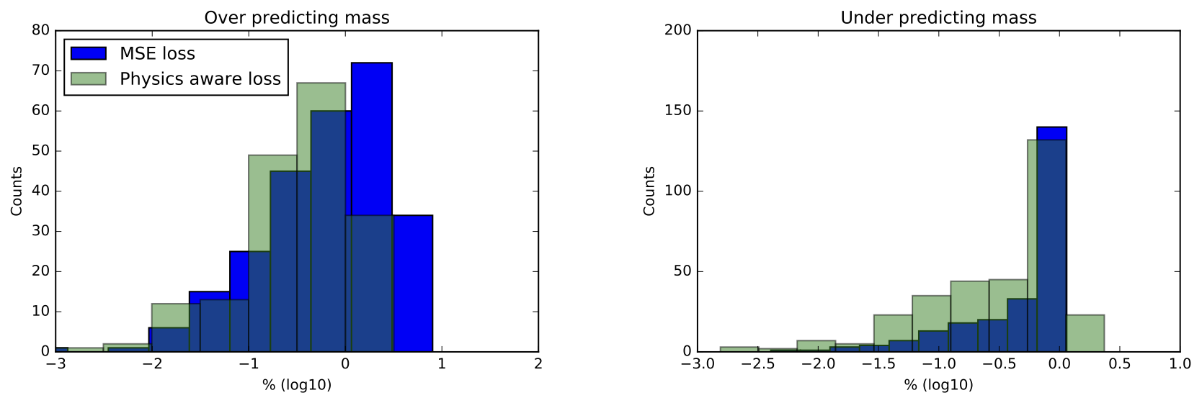
Incorporating domain knowledge
Neural networks

Slide 32
Incorporating domain knowledge
Neural networks

Slide 33
Incorporating domain knowledge
Neural networks
Change output layer activation from linear to ReLU (or similar)
Modifying network architecture:
This is not new, to get a probability, we use a sigmoid!
Notes:
Picture of neural net
Gradient descent
Loss function

Slide 34
Incorporating domain knowledge
Neural networks
Modifying network architecture for symmetries:
Suppose you want your function to be symmetric for input 1 and 2.
Meaning:
A dirty way to do this is to make an ensemble prediction. Evaluate the model twice and the prediction is the average of both.
Notes:
Picture of neural net
Gradient descent
Loss function

Slide 35
Incorporating domain knowledge
Neural networks
Paper with remi
Notes:
Loss function with external things

Slide 36
Incorporating domain knowledge
Neural networks
Modifying network architecture for symmetries:
Suppose you want your function to be symmetric for input 1 and 2.
Meaning:
A dirty way to do this is to make an ensemble prediction. Evaluate the model twice and the prediction is the average of both.
Computationally intractable for most things
Notes:
Picture of neural net
Gradient descent
Loss function

Slide 37
Incorporating domain knowledge
Neural networks
Invariant neural nets
Notes:
Picture of neural net
Gradient descent
Loss function

Slide 38
Incorporating domain knowledge
Neural networks
Framework chinesta
Notes:
Picture of neural net
Gradient descent
Loss function

Slide 39
Incorporating domain knowledge
Kernel methods
Gaussian processes
Notes:
- Include only positive kernels

Slide 40
Incorporating domain knowledge
Bayesian methods
Notes:
Include prior information

Slide 41
Incorporating domain knowledge
Summary
Modifying neural network
structure
Modifying loss function
Soft-constraint
Hard-constraint
CNN:
translation & rotation
Equivariant
Invariant
Notes:
Include prior information

Slide 42
Towards the future
Weinan E
A summary of his results
Notes:
Weinan E, a professor in Princeton well known in the field of computational mathematics has been trying to put Machine learning in a similar framework
In numerics, we have proofs of convergence, error bounds and when we don’t have analytical solutions (for most nonlinear problems), we have benchmark problems that give us an impression

Slide 43
Reproducibility in (Scientific) Machine Learning

Slide 44
Agenda
State of affairs
Types of reproducibility
Reproducibility checklist
Useful tools

Slide 45
State of affairs
There’s no standard practices for ML development in the scientific context
There are various guides in industry (e.g: google hand book, etc)
There is a difference between ML for industry and ML for academia

Slide 46
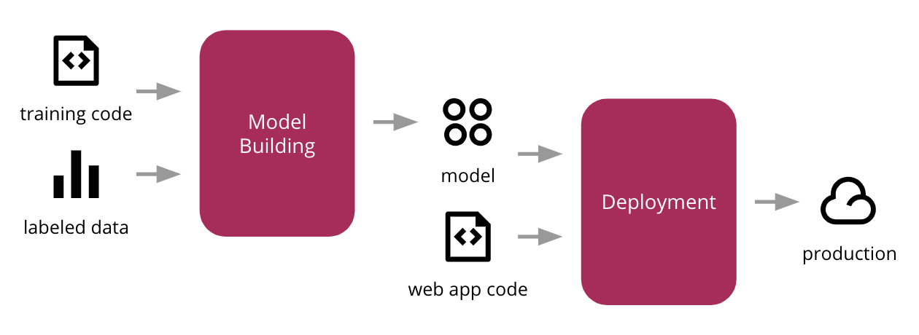
Scientific ML vs Industry ML
Iterative process
Business question
Paper
Scientific question
Dataset
re-use
Notes:
Typically, we are not interested in deploying an online ML system.
We usually operate in a more controlled execution environment. (No end users)
We want the system to be reproducible.

Slide 47
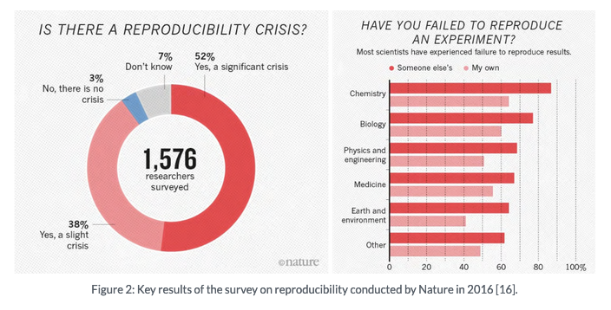
Reproducibility
Notes:
ML reproducibility is not the first time that we come across issues with reproducing scientific results. A survey conducted in 2016 shows that in “hard” sciences, many fields struggle with reproducibility (this becomes worse in soft sciences).

Slide 48
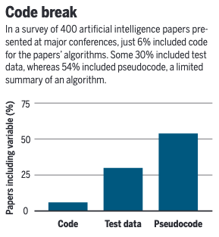
Reproducibility in ML
Notes:
An article in science magazine from 2018 looked at 400 articles from top journals / conferences and has found that:
- unable to reproduce cutting edge results - paper by goodman eventually retracted
people don’t share their code - 2018 - 6% of authors shared codes in 400 algos
Training data is not shared
Sensitivity to hyperparameters
And this is in machine learning conferences, not scientific fields that are using ml as a tool. Best believe this is worst…

Slide 49
Types of reproducibility
According to Goodman et al. [1], there are 3 types of reproducibility:
Methods
Results
Inferential
Notes:
An article in science magazine from 2018 looked at 400 articles from top journals / conferences and has found that:
- unable to reproduce cutting edge results - paper by goodman eventually retracted
people don’t share their code - 2018 - 6% of authors shared codes in 400 algos
Training data is not shared
Sensitivity to hyperparameters

Slide 50
Methods reproducibility
Ill add reference
Methods reproducibility is (…) the ability to implement, as exactly as possible, the experimental and computational procedures, with the same data and tools, to obtain the same results as in an original work.
Methods reproducibility involves providing enough detail about the procedures and data in the study so the same procedures could be exactly repeated.
Notes:
An article in science magazine from 2018 looked at 400 articles from top journals / conferences and has found that:
- unable to reproduce cutting edge results - paper by goodman eventually retracted
people don’t share their code - 2018 - 6% of authors shared codes in 400 algos
Training data is not shared
Sensitivity to hyperparameters

Slide 51
Methods reproducibility
Why is it important?
….
Notes:
An article in science magazine from 2018 looked at 400 articles from top journals / conferences and has found that:
- unable to reproduce cutting edge results - paper by goodman eventually retracted
people don’t share their code - 2018 - 6% of authors shared codes in 400 algos
Training data is not shared
Sensitivity to hyperparameters

Slide 52
Methods reproducibility
What are the difficulties?
Keeping exact track of experiments:
Hyper-parameter choice
Non-deterministic aspects of methods:
random initialization
shuffling of dataset (generating different training, test and validation sets)
regularisation through drop-out
Stochastic gradient descent type optimization
Changes in machine learning frameworks / non consistent development environments
Non-deterministic CPU/GPU floating-point calculations when it comes to parallelizing
Notes:
An article in science magazine from 2018 looked at 400 articles from top journals / conferences and has found that:
- unable to reproduce cutting edge results - paper by goodman eventually retracted
people don’t share their code - 2018 - 6% of authors shared codes in 400 algos
Training data is not shared
Sensitivity to hyperparameters

Slide 53
Methods reproducibility
What can we do?
Provide details on:
Code
Dataset
Development environment (e.g.: docker or virtual environment)
Computational platform
Notes:
An article in science magazine from 2018 looked at 400 articles from top journals / conferences and has found that:
- unable to reproduce cutting edge results - paper by goodman eventually retracted
people don’t share their code - 2018 - 6% of authors shared codes in 400 algos
Training data is not shared
Sensitivity to hyperparameters

Slide 54
Results reproducibility
Results reproducibility is (…) the ability to produce corroborating results in a new (independent) study having followed the same experimental procedures.
Notes:
An article in science magazine from 2018 looked at 400 articles from top journals / conferences and has found that:
- unable to reproduce cutting edge results - paper by goodman eventually retracted
people don’t share their code - 2018 - 6% of authors shared codes in 400 algos
Training data is not shared
Sensitivity to hyperparameters

Slide 55
Results reproducibility
Why is it important?
…
Notes:
An article in science magazine from 2018 looked at 400 articles from top journals / conferences and has found that:
- unable to reproduce cutting edge results - paper by goodman eventually retracted
people don’t share their code - 2018 - 6% of authors shared codes in 400 algos
Training data is not shared
Sensitivity to hyperparameters

Slide 56
Results reproducibility
What are the difficulties?
…
Notes:
An article in science magazine from 2018 looked at 400 articles from top journals / conferences and has found that:
- unable to reproduce cutting edge results - paper by goodman eventually retracted
people don’t share their code - 2018 - 6% of authors shared codes in 400 algos
Training data is not shared
Sensitivity to hyperparameters

Slide 57
Results reproducibility
What can we do?
…
Notes:
An article in science magazine from 2018 looked at 400 articles from top journals / conferences and has found that:
- unable to reproduce cutting edge results - paper by goodman eventually retracted
people don’t share their code - 2018 - 6% of authors shared codes in 400 algos
Training data is not shared
Sensitivity to hyperparameters

Slide 58
Inferential reproducibility
A study is (…) inferential reproducible when an independent replication of the study or a reanalysis of it arrives at qualitatively similar conclusions to that of the original study.
Notes:
An article in science magazine from 2018 looked at 400 articles from top journals / conferences and has found that:
- unable to reproduce cutting edge results - paper by goodman eventually retracted
people don’t share their code - 2018 - 6% of authors shared codes in 400 algos
Training data is not shared
Sensitivity to hyperparameters

Slide 59
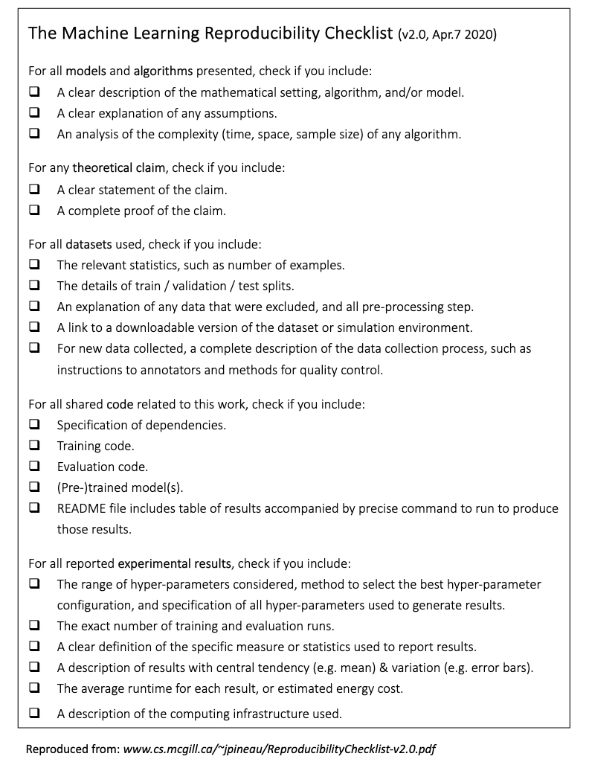
The Machine Learning Reproducibility Checklist
Notes:
An article in science magazine from 2018 looked at 400 articles from top journals / conferences and has found that:
- unable to reproduce cutting edge results - paper by goodman eventually retracted
people don’t share their code - 2018 - 6% of authors shared codes in 400 algos
Training data is not shared
Sensitivity to hyperparameters

Slide 60
Tools that can help us

